Slide 1
EE209 - Fundamentals of Electrical & Electronics Engineering
Asst. Prof. Mustafa Mert Ankarali

Slide 2
Review
Ohm’s law & Resistivity
Kirchhoff's Current Law
Kirchhoff's Voltage Law
Concepts: Node, Branch, Loop, Mesh
Paralel & Series resistors
Delta-Wye Connections

Slide 3
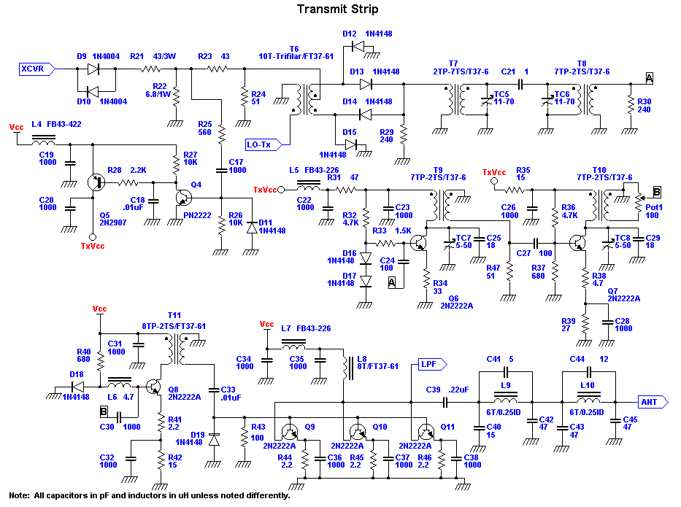
Analysis methods
Scalability?

Slide 4
Analysis methods
1-Nodal Analysis
Unknown: Node Voltages
Uses Kirchhoff's Current Law
2-Mesh Analysis
Unknown: Mesh Currents
Uses Kirchhoff's Voltage Law

Slide 5
Steps for nodal analysis
1-Choose a reference node (ground)
2-Label node voltages
3-Write KCL equations for each node
4-Solve the equations

Slide 6
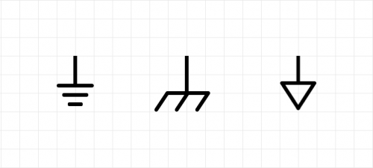
Choosing reference node
Node that interconnects the most branches.
Usually at the bottom of circuit.
Label ground with one of the symbols below:

Slide 7
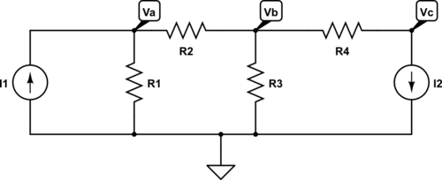
Label each node voltage
Except ground node

Slide 8
Write KCL for each node
Incoming Currents + Outgoing Currents = 0
Suggested convention:
Use − sign for incoming currents
Use + sign for outgoing currents

Slide 9
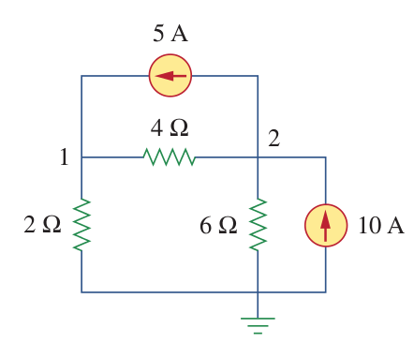
Example 1
Calculate node voltages

Slide 10
Example 1
Answer: V1 = 40/3 V & V2 = 20 V

Slide 11
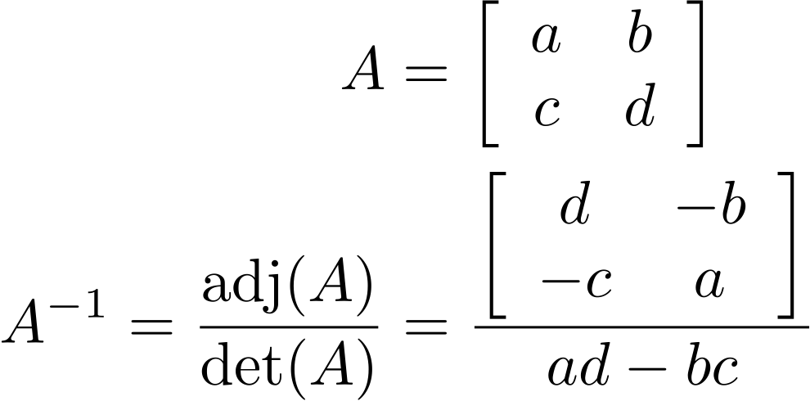
Inverse of a 2x2 matrix

Slide 12
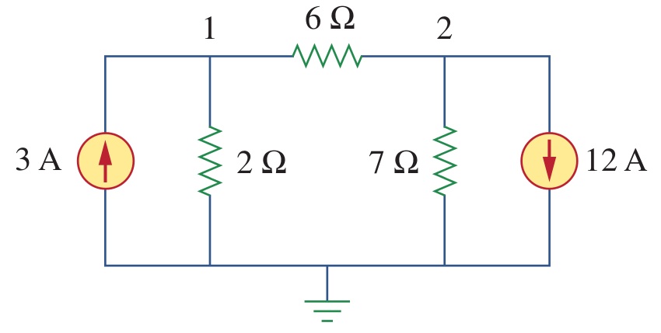
Example 2
Answer: V1 = -6 V & V2 = -42 V

Slide 13
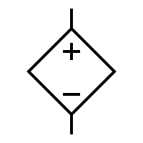
Dependent sources
Dependent voltage sources
Shown with a square sign
Its value is dependent on another variable

Slide 14

Dependent sources
Dependent current sources
Shown with a square sign
Its value is dependent on another variable

Slide 15
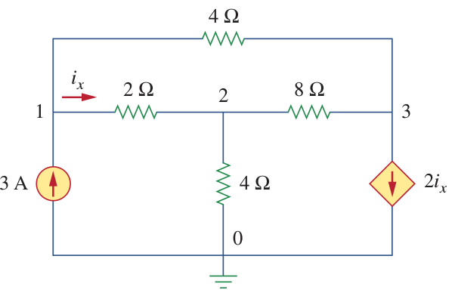
Example 3

Slide 16
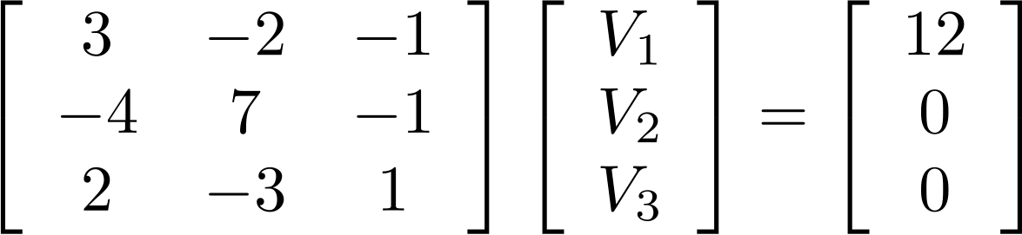
Example 3

Slide 17
Example
Answer: V1 = 4.8 V, V2 = 2.4 V, & V3 = -2.4 V

Slide 18

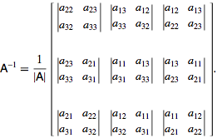
Inverse of a 3x3 matrix
Source: http://mathworld.wolfram.com/MatrixInverse.html

